Slide 1
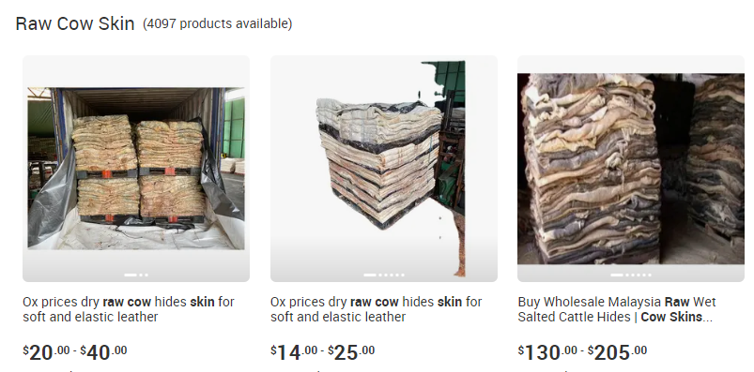

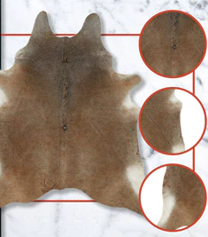
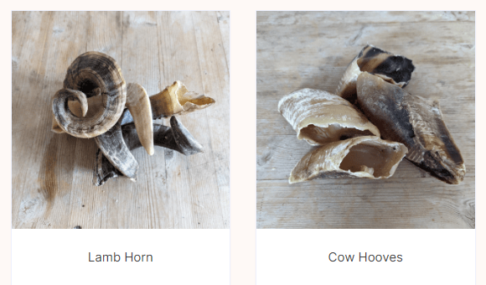
Butcher to tannery/horn business direct communication
Advertise and sell hides and horns online to butcher and tannery respectively
Getting cattle parts at a fair price
Pricing done by specific conditions and algorithm
Annihilating the presence of syndicates in between Butchers and Tannery or other business

Slide 2
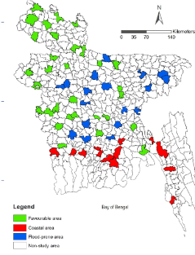
Butcher to tannery/horn business direct communication
Country wide connectivity between butchers and tannery/horn business
Butchers
Tannery
Horn business

